Slide 1

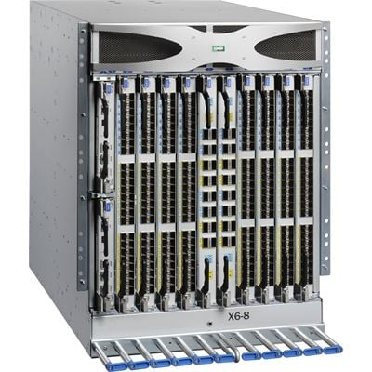
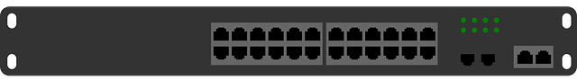
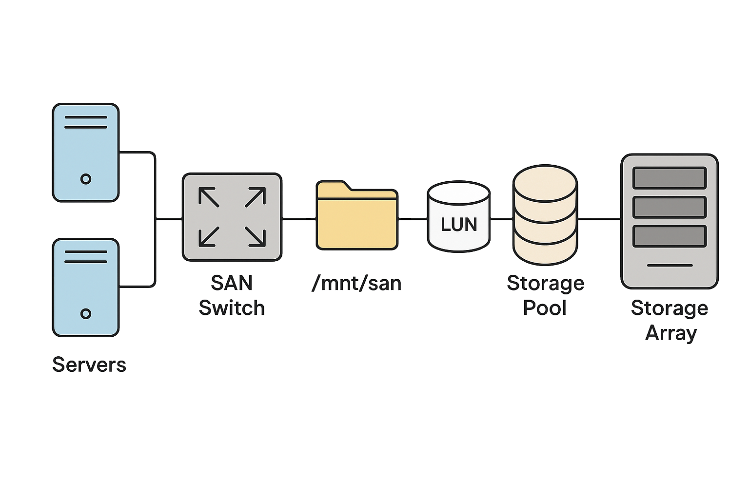
High Utilization Servers
Different
Domain
SAN Director
External Switch
SAN Storage
Low Utilization Servers

